Slide 1
Sounds and Actions

Slide 2
Remember ‘My turn, your turn’
Say the sound out loud
Then say the sound and do the action

Slide 4
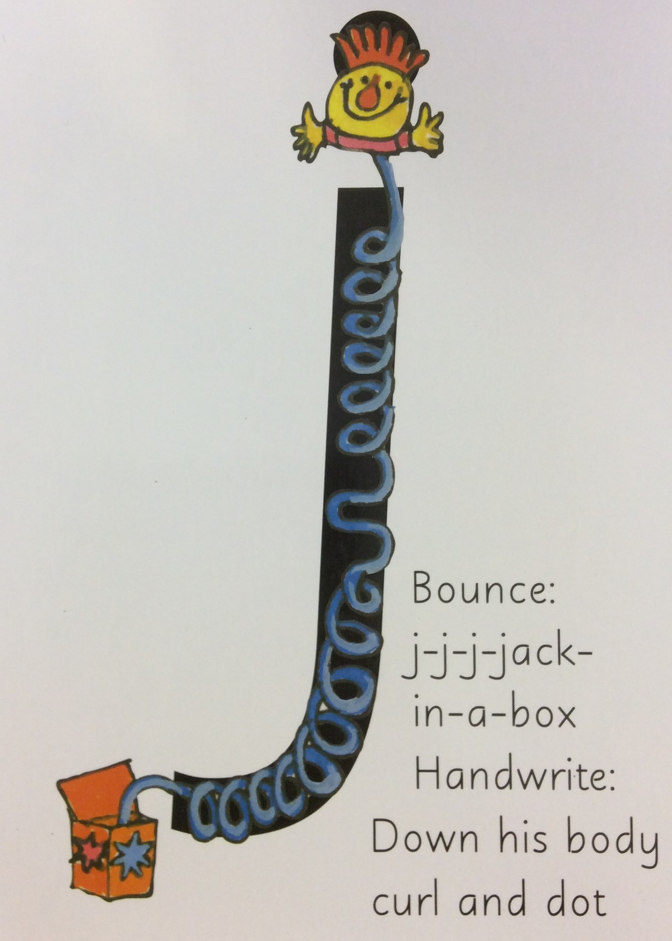

Slide 25
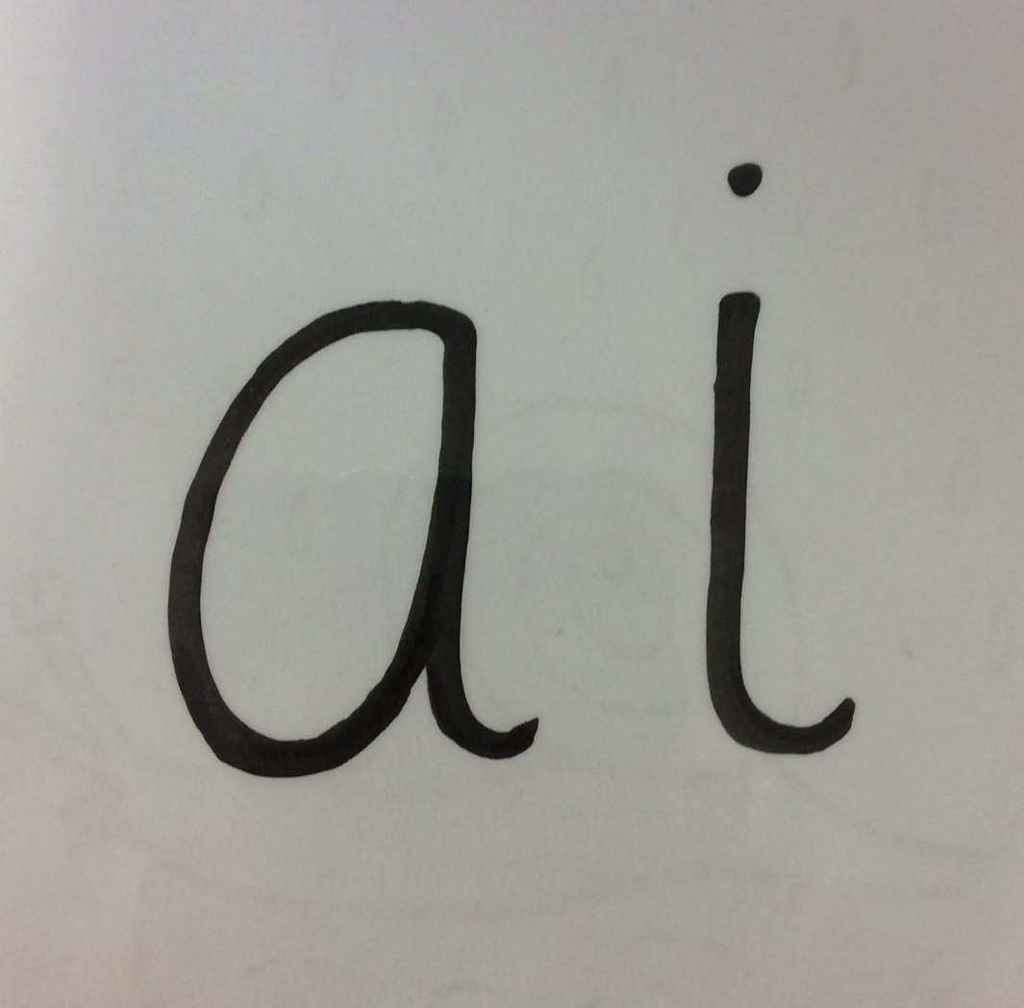

Slide 27
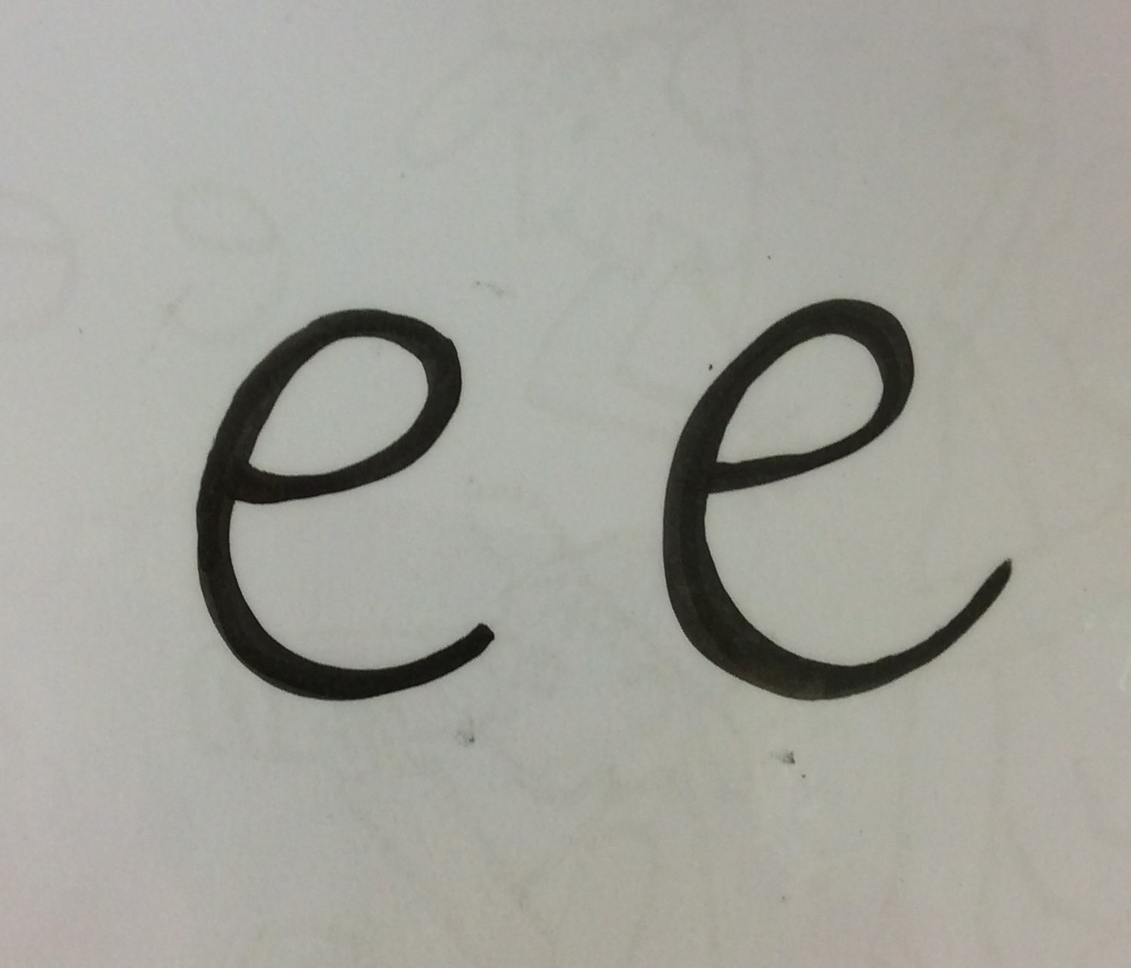

Slide 28
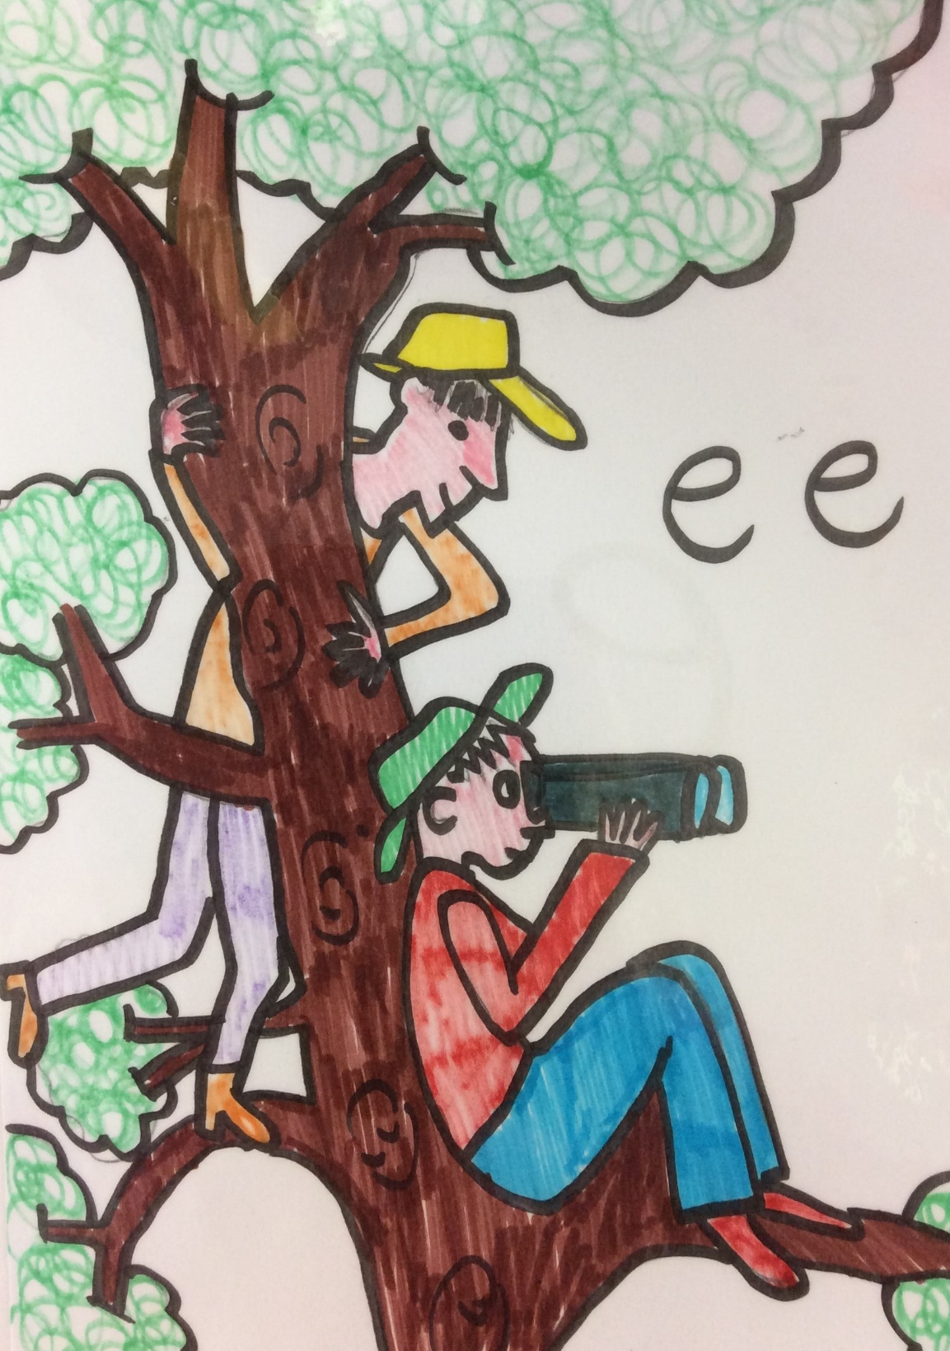

Slide 29
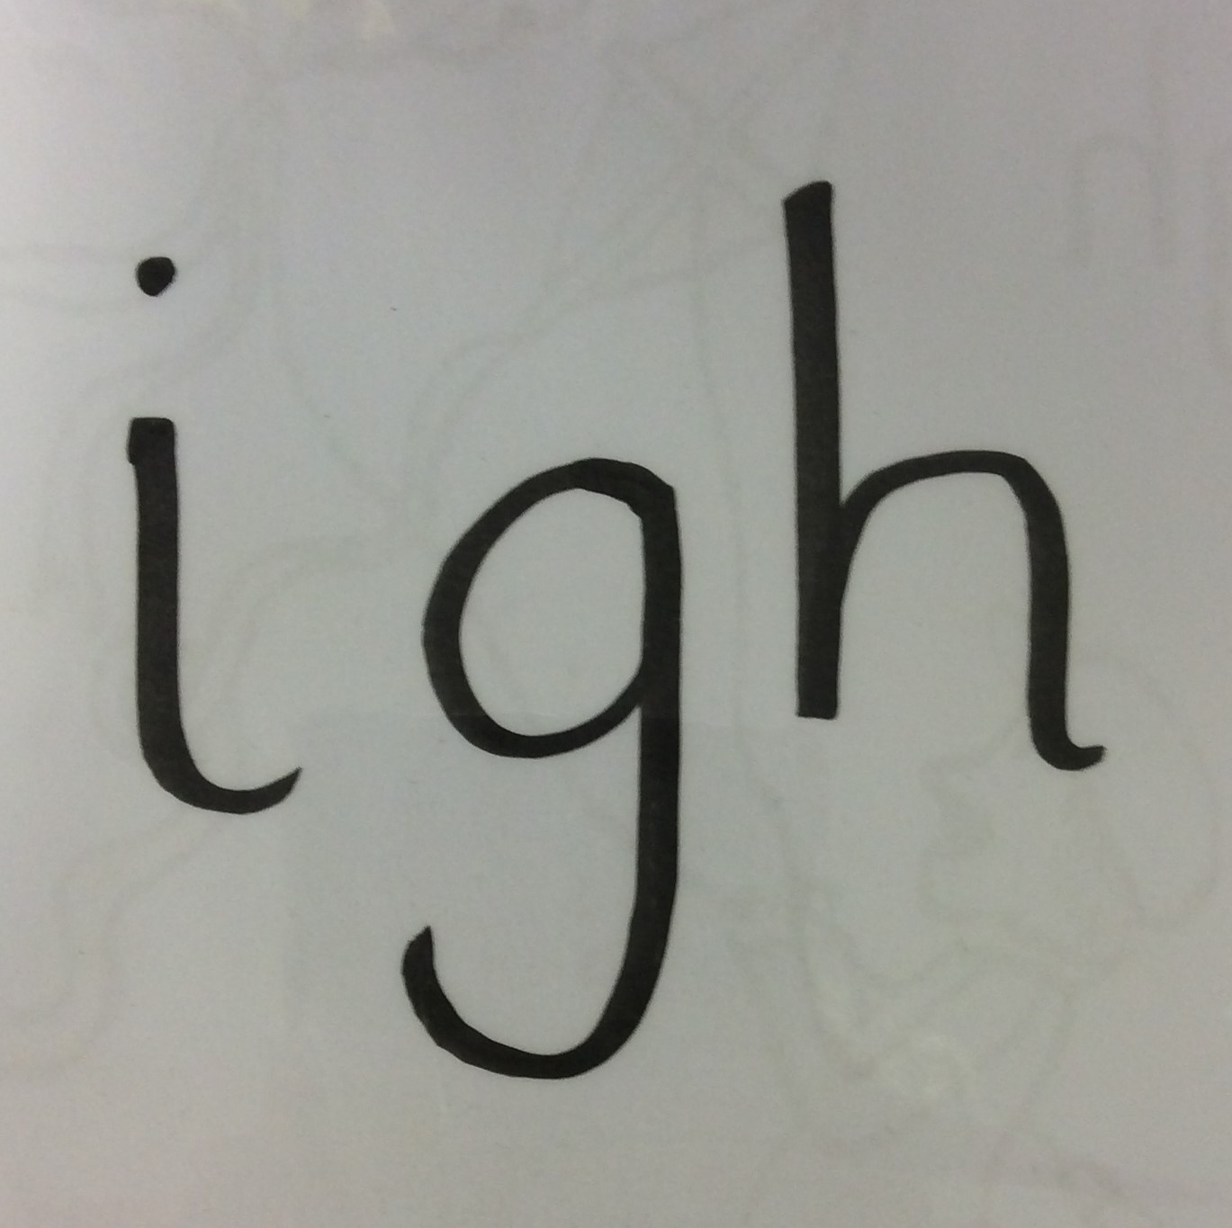

Slide 55
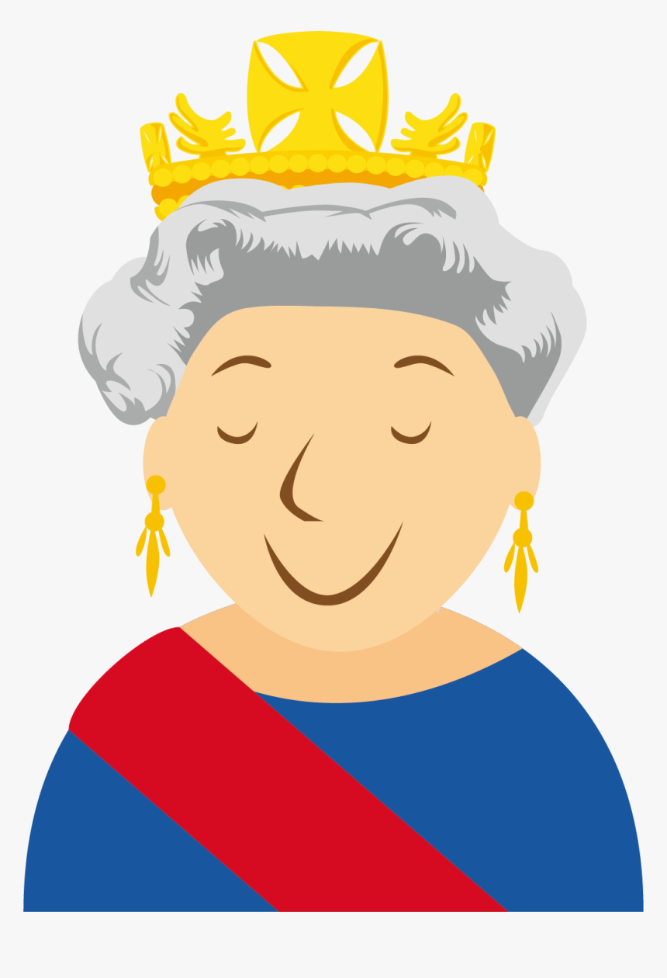
qu
ee
n

Slide 56
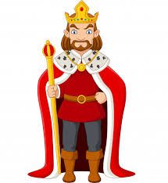
ng
k
i

Slide 57
Tricky Words
Look and say

Slide 58
he

Slide 59
she

Slide 60
we

Slide 61
me

Slide 62
my

Slide 63
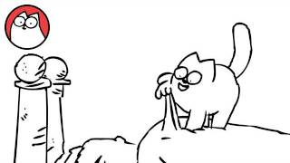
The cat is on the bed.

Slide 64
Well done!
Give yourself a big ‘firework clap’

