Slide 1
Word of the Day
incriminated

Slide 2
Clap Syllables
in / crim / in / a / ted

Slide 3
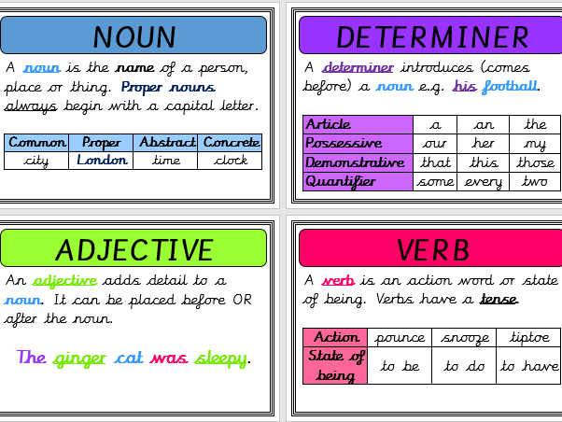
Definition and word class

Slide 4
Word of the Day
incriminated : (verb) if something incriminates you, it suggests you are involved in a crime

Slide 5
Write 3 times incriminated incriminated incriminated

Slide 6
Speed write for 1 minute! incriminated

Slide 7
Exemplar Sentence
With the evidence mounting against him, there was no doubt that he was incriminated in the crime; however Sherlock Holmes still felt uneasy – was this a little too convenient?

Slide 8
Oral Creation and Rehearsal

Slide 9
Orally share, edit and improve

Slide 10
Write

Slide 11
Share, edit and celebrate!

