Slide 1
Word of the Day
Cascade

Slide 2
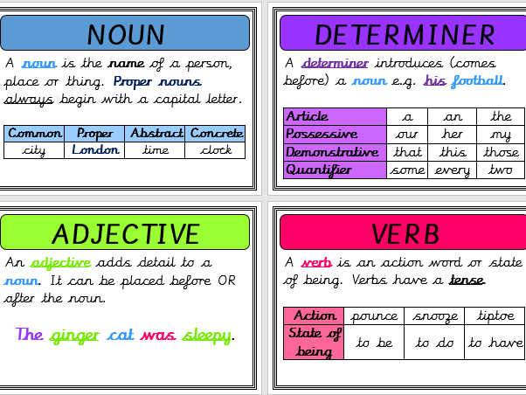
Definition and word class

Slide 3
Word of the Day
Cascade (verb)
Pour downwards rapidly and in large quantities (usually water)

Slide 4
Write 3 times cascade cascade cascade

Slide 5
Speed write for 1 minute! Cascade

Slide 6
Exemplar Sentence
Unfortunately, the young man (who had forgotten his umbrella) looked drenched following the cascade of raindrops that fell from the rather grey, gloomy sky on his way to work.

Slide 7
Oral Creation and Rehearsal

Slide 8
Orally share, edit and improve

Slide 9
Write

Slide 10
Share, edit and celebrate!

