Slide 1
Word of the Day
Twister

Slide 2
Pronunciation

Slide 3
Clap Syllables

Slide 4
Definition
Someone that twists or repeatedly turns something.
A tornado or whirlwind.

Slide 5
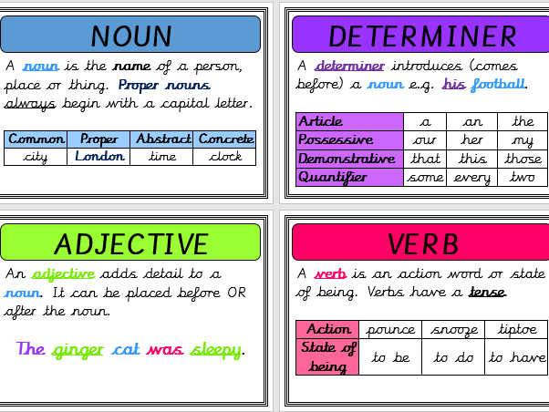
Word Class
Noun
What is the root of this word?
What part of this word turns it from a verb into a noun?

Slide 6
Exemplar Sentence
The twister cut through the mid-west town sucking up trees, cars and houses.

Slide 7
Oral Creation and Rehearsal

Slide 8
Orally Share

Slide 9
Orally Edit and Challenge

Slide 10
Write

Slide 11
Share, edit and celebrate!

