Slide 1
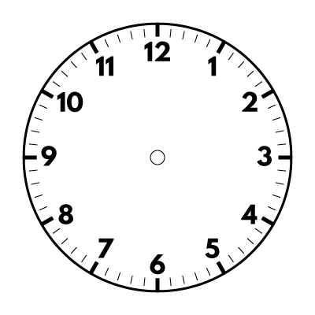
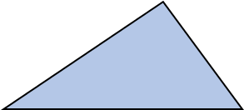
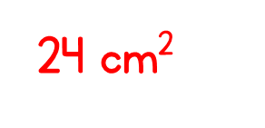
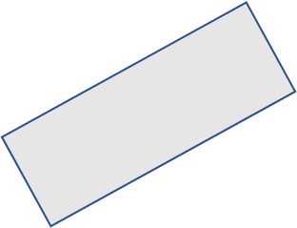
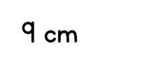
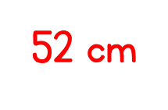
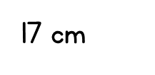
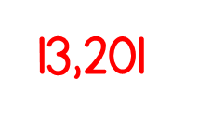
Year 6 | Week 9 | Day 3

Slide 3
What is the volume of each 3D shape?
If the volume of each cube is 1 cm³, what is the volume of each shape?
___ cubes
___ cubes
___ cubes

Slide 4
What is the volume of each 3D shape?
If the volume of each cube is 1 cm³, what is the volume of each shape?
6
6
6
___ cubes
___ cubes
___ cubes
5 cm³
9 cm³

Slide 5
03.03.21 WALT – find volume by counting squares S.C - know that volume describes the solid space that an object takes up - know that volume is measured in cubic units - begin to measure volume by counting cubes - understand and use units of volume e.g. cmᵌ

Slide 6
Vocabulary volume cm³ m³ cubed cubic cm/m space within space take up by height length width

Slide 8
Have a think
What is the volume of each 3D shape?
Volume $=$ 7 cubes
Volume $=$ 7 cubes
Volume $=$ 13 cubes

Slide 9
Have a think
I needed 16 cubes to build this cuboid.
Volume $=$ 16 cubes
Volume $=$ 13 cubes

Slide 10
Have a think
What is the volume of this 3D shape?
Volume $=$ 18 cubes
6 cubes
$+$6 cubes
$+$6 cubes
12 cubes
$+$6 cubes

Slide 11
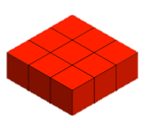
Have a think
If one cube is worth 1 cm³, what is the volume of this shape?
3
2
6
1
5
9
4
8
7
18 cm³

Slide 12
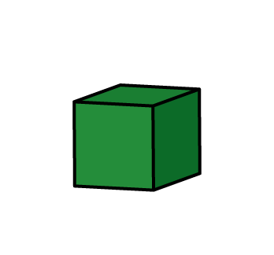
Have a think
If one cube is worth 1 cm³, which shape has the greater volume?

Slide 13
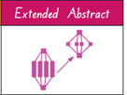
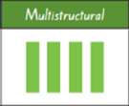
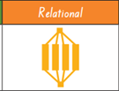
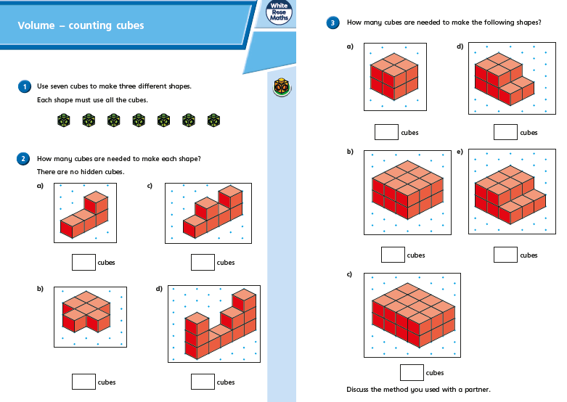
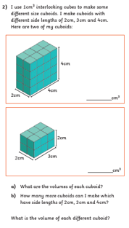
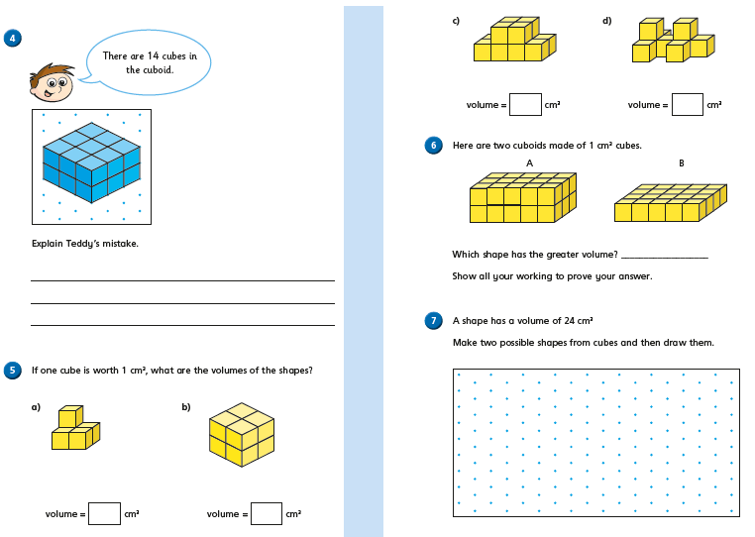
Today’s Activities:
Challenge – not for first choice

Slide 14
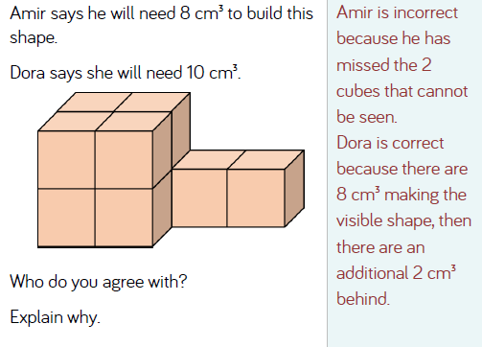
Discuss in pairs….
Then share.

