Slide 2
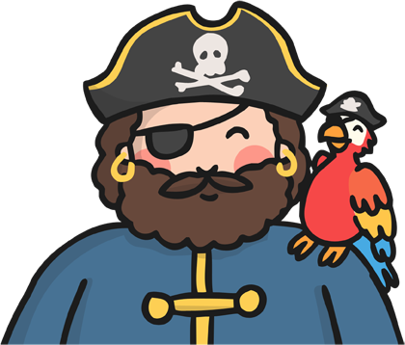
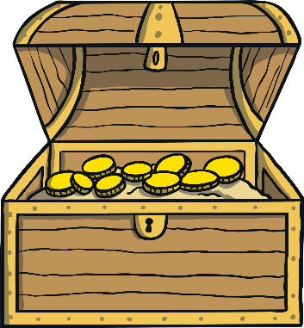
Ahoy, me hearties!
I am Captain Ten.
My pirate crew and I have finally reached the shores of Ten-Frame Island.
It is said that there be treasure chests filled with ten-frames of gold and jewels!
Pirates are not very good at counting so we need your help! Can you help us be sure that each ten-frame has 10 pieces of treasure?

Slide 3
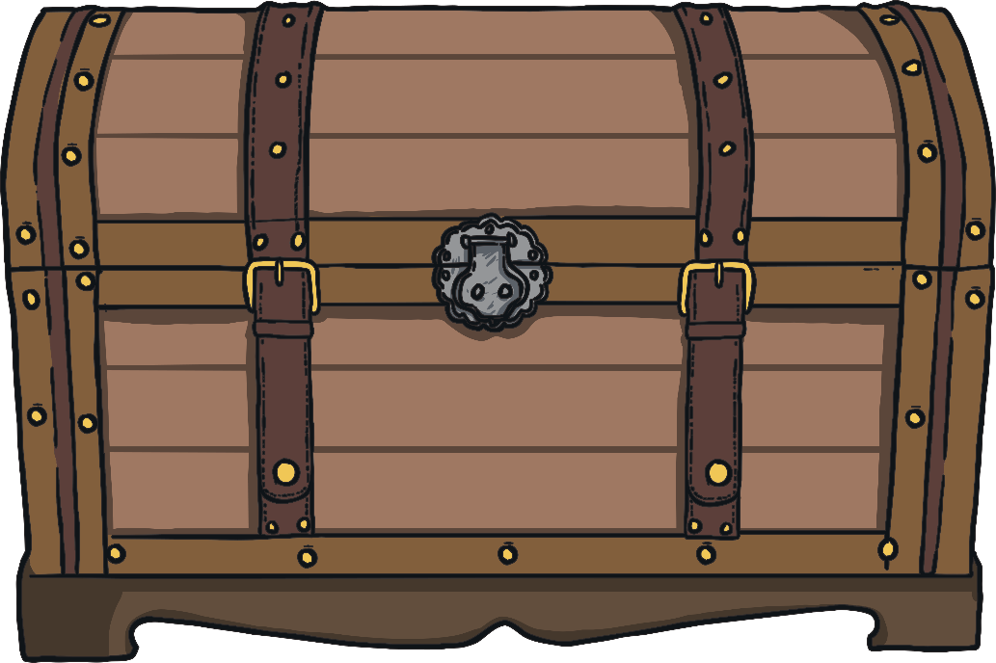
Arr! I spy our first treasure chest. Let’s open it to see how many pieces of treasure there be.

Slide 4
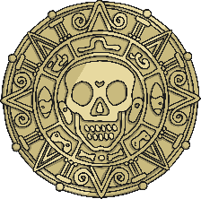
Ahoy me hearties! Can you help Captain Ten count the gold coins in the chest? Once you have counted them, whisper the number to your friend, as there may be other pirates about! Did you count the same number as your friend?
There are 10 coins altogether.

Slide 5
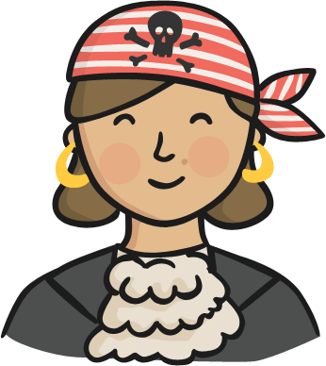
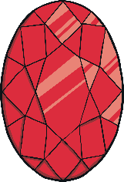
Ahoy!
My name is Pirate Charlotte. I have found another treasure chest! This one has 1 red ruby. How many gold coins are there?
Are there still 10 pieces of treasure in total?

Slide 6
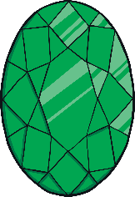
Shiver me timbers! I’ve found another chest. This time, there are 2 emeralds with some gold coins. Can you count the pieces of treasure? Are there 10 pieces altogether?

Slide 7
We need to record our findings. Can you help me complete the number sentence? Click on the missing number.
8
+
=
10
1
2
4

Slide 8
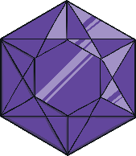
We have found another chest! Can you complete the number sentence to show what we’ve found? Click on the missing number.
+
7
=
10
6
5
3

Slide 9
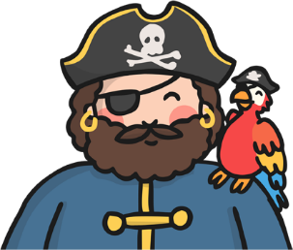
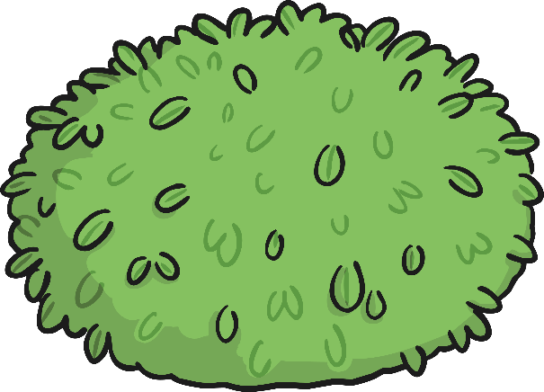
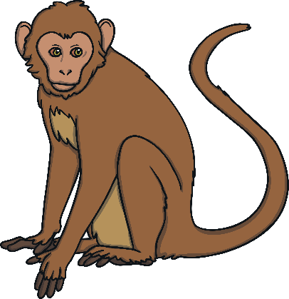
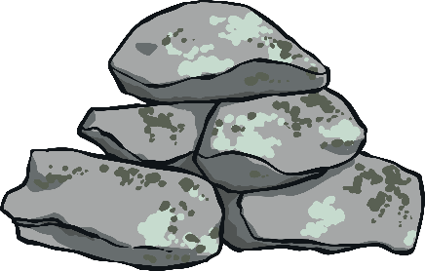
Arr! There be jewels missing from this treasure chest. How many jewels are missing? How do you know?
Find the missing jewels hidden in this picture and click them to add them to the ten-frame.
+
6
=
10
5
4
7

Slide 10
How are the treasure chests on Ten-Frame Island similar? How are they different?
Before you count this treasure, can you make a sensible guess about how many jewels are missing from this chest? Why do you think that?
+
5
=
10
4
10
5

Slide 11
Well done me hearties! You have helped us to count all of the treasure on Ten-Frame Island.

