Slide 1
Stanley’s stick

Slide 2
WALT:
to use our imagination.

Slide 3
Shared reading
https://www.youtube.com/watch?v=HfIuIQaOLlY
to part where Stanley throws it into sea

Slide 4
Word of the day!
pretending
What do you think this word means?
Draw it!
Can you use it in a sentence – write the sentence down.

Slide 5
Word of the day!
pretending
behave so as to make it appear that something is the case when in fact it is not.

Slide 6
A fantasy is something you imagine, which might involve dragons, unicorns, or an imaginary best friend. If you live in a fantasy world, you're not worrying much about reality — pleasant, maybe, but not very practical. Fantasy is dreams and imagination.
Fantasy
Can you think of some examples? Maybe stories that you have read?

Slide 7
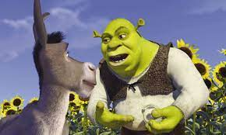
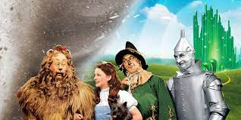
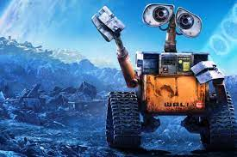
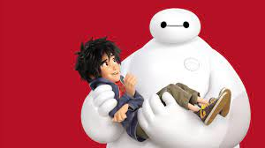
What are all of these examples of?

Slide 8
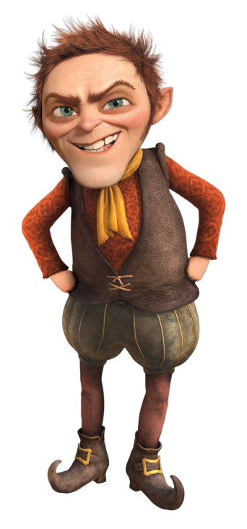
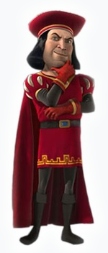
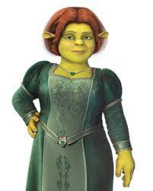
Good characters Evil/bad characters
Donkey Lord Farquaad
Shrek Rumplestiltskin
Princess Fiona
How do good and evil characters act?
Do they have the same characteristics or are they very different?

Slide 9
Good characters
Evil/bad characters

Slide 10
Your task!
Use your imagination!!
Choose a good character or an evil character.
Decide how they act. How would they move? What would they say?
You could use your imagination ‘fantasticks’ to help you too
Act out being this character and ask a grown up to record and upload it.
Remember!

