Slide 1
22.03.21 WALT – use scale factors

Slide 2
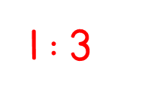
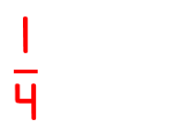
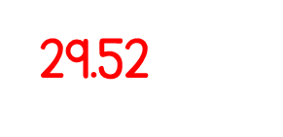
Year 6 | Week 11 | Day 1

Slide 4
Mo runs twice as far as Eva. If Eva runs 500 m, how far does Mo run?
Dora builds a tower that is 4 times the height of Tommy’s tower.
If Tommy’s tower is 40 cm. How tall is Dora’s tower?
3) Whitney’s saved triple the amount of money Rosie has. If Whitney has saved £45, how much has Rosie saved?

Slide 5
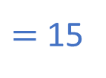
Mo runs twice as far as Eva. If Eva runs 500 m, how far does Mo run?
Dora builds a tower that is 4 times the height of Tommy’s tower.
If Tommy’s tower is 40 cm. How tall is Dora’s tower?
3) Whitney’s saved triple the amount of money Rosie has. If Whitney has saved £45, how much has Rosie saved?
500 $×$ 2
$=$ 1,000 m
1 km
4$×$ 40
$=$ 160 cm
1.6 m
45
45 $÷$ 3
$=$ 15
W
15
15
15
R
15
£15

Slide 6
22.03.21 WALT – use scale factors S.C - know that a scale factor is a rule for enlarging in size - make links with multiplication tables to enlarge shapes accurately - know when a shape is enlarged or reduced, the sides change in length but the angles remain the same

Slide 7
scale factor enlarge multiply rule shape length side angle
Vocabulary

Slide 9
Here is a rectangle.
Draw another rectangle where each side is three times as big.
1 $×$ 3 $=$ 3
3 $×$ 3 $=$ 9
1 $×$ 3 $=$ 3
3 $×$ 3 $=$ 9
This shape has been enlarged by a scale factor of
3

Slide 10
Here is an irregular hexagon.
Enlarge the hexagon by a
scale factor of 2
This shape has been enlarged by a scale factor of
2

Slide 11
Enlarge the triangle by a scale factor of 2
Have a think

Slide 12
Here is a triangle.
Enlarge the triangle by a scale factor of 4
6 $×$ 4 $=$ 24 cm
5 $×$ 4 $=$ 20 cm
6 cm
24 cm
5 cm
20 cm

Slide 13
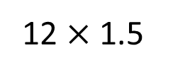
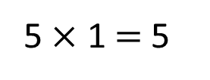
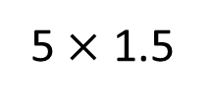
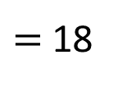
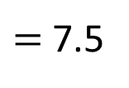
This rectangle has been enlarged by a scale factor of 1$\frac{\text{1}}{\text{2}}$
12 cm
$=$ 7.5
12 $×$ 1.5
$=$ 18
5 $×$ 1.5
5 $×$ 1 $=$ 5
5 cm
12 $×$ 1 $=$ 12
Have a think
5 $×$ 0.5 $=$ 2.5
12 $×$ 0.5 $=$ 6
Fill in the dimensions of the new shape.
18 cm
7.5 cm

Slide 14
Rectangle A has been enlarged by a scale factor of 3 to make rectangle B.
Find the perimeter of each rectangle.
6 cm
18 cm
4 cm
A
12 cm
B
Perimeter of A
4 $+$ 4 $+$ 6 $+$ 6 $=$ 20 cm
4 $×$ 3 $=$ 12 cm
Perimeter of B
12 $+$ 12 $+$ 18 $+$ 18 $=$ 60 cm
18 $÷$ 3 $=$ 6 cm
20 cm
60 cm
Perimeter of A $=$ _____ Perimeter of B $=$ _____

Slide 15
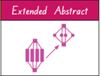
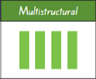
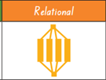
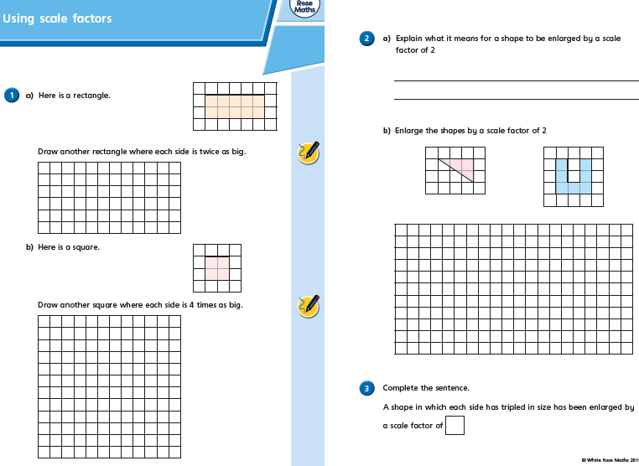
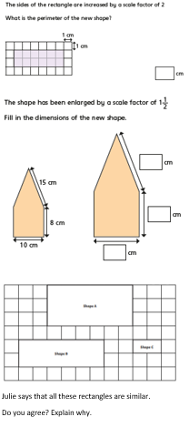
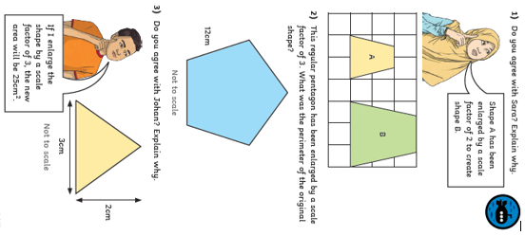
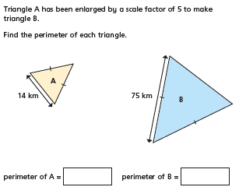
Today’s Activities:
Challenge – not for first choice

Slide 16
22.03.21 WALT – use scale factors S.C - know that a scale factor is a rule for enlarging in size - make links with multiplication tables to enlarge shapes accurately - know when a shape is enlarged or reduced, the sides change in length but the angles remain the same

Slide 17
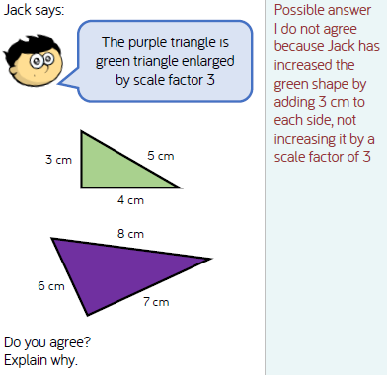
Discuss in pairs….
Then share.

