Slide 1
Word of the Day
Selfish

Slide 2
Pronunciation

Slide 3
Clap Syllables

Slide 4
Definition
Someone who only thinks of themselves.

Slide 5
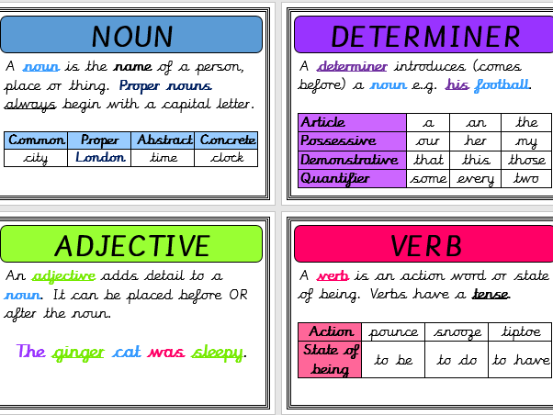
Word Class
Adjective
It’s an Anglo-Saxon word!
Can you guess what selfless means?

Slide 6
Exemplar Sentence
Veruca was a very selfish girl and therefore, only thought about herself.

Slide 7
Oral Creation and Rehearsal

Slide 8
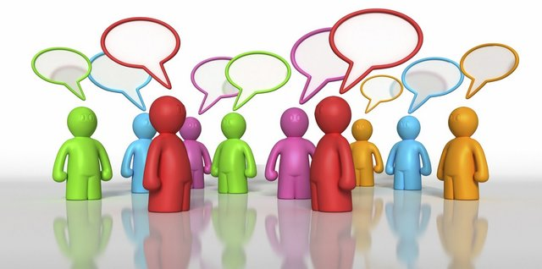
Orally Share

Slide 9
Orally Edit and Challenge

Slide 10
Write

Slide 11
Share, edit and celebrate!

