Slide 1
Question Marks
You will spot question marks at certain points in this Lesson Presentation.
Clicking the question marks will bring up key questions.
The assessment questions that appear will enable you to check your understanding against the lesson aim and success criteria.

Slide 3
WALT: Identify stereotypes and discuss how scientists are a diverse group of people
Success Criteria
I can explain what the words ‘stereotype’ and ‘diversity’ mean and use them in the context of science.
I can discuss the diversity of scientists’ backgrounds, job roles and places of work.
I can describe what is involved in a range of scientist roles.

Slide 4
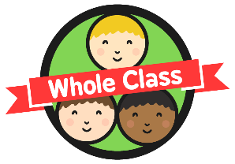
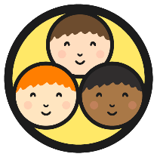
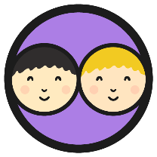
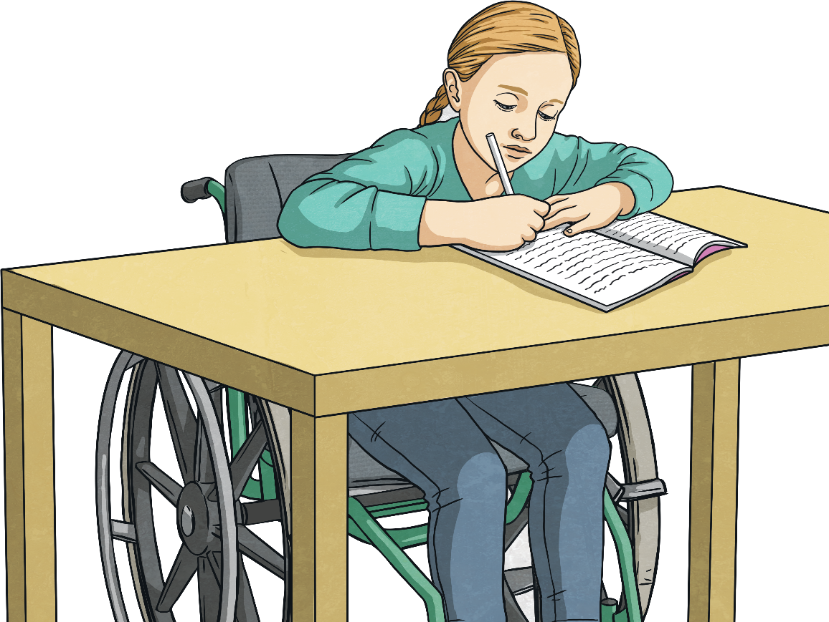
What Is a Scientist?
Using the What Is a Scientist? Activity Sheet, write a definition of what a 'scientist' is. Then, draw a picture of what you think a scientist looks like. You have 5 minutes.
12
TIME’S UP!
11
1
START TIMER
10
2
9
3
8
4
7
5
6

Slide 5
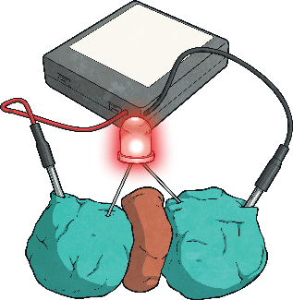
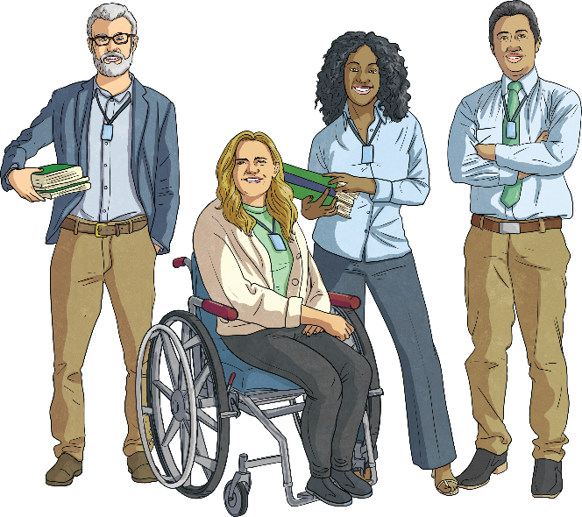
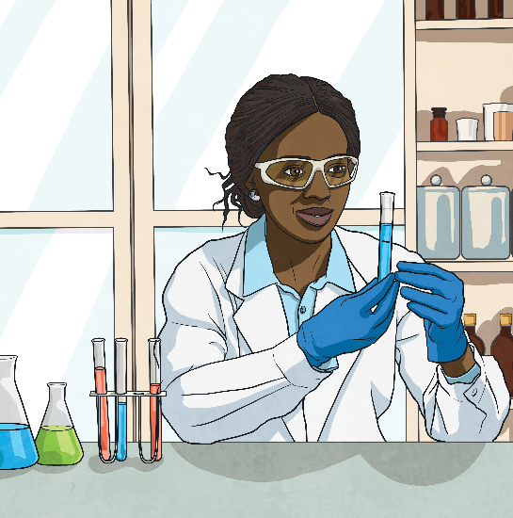
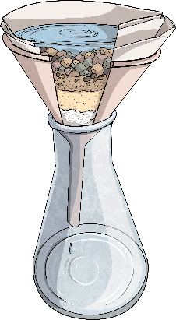
What Is a Scientist?
Scientists study science. They are curious about how the world works and finding out new knowledge.
Scientists can have many different skills and their work may include:
Making observations.
Asking questions.
Coming up with ideas about how the world works and testing them.
Carrying out experiments and recording data.
Teaching and training other people.
Look at your definition of a scientist. Have you got any of these points?
Is there anything you would add?

Slide 6
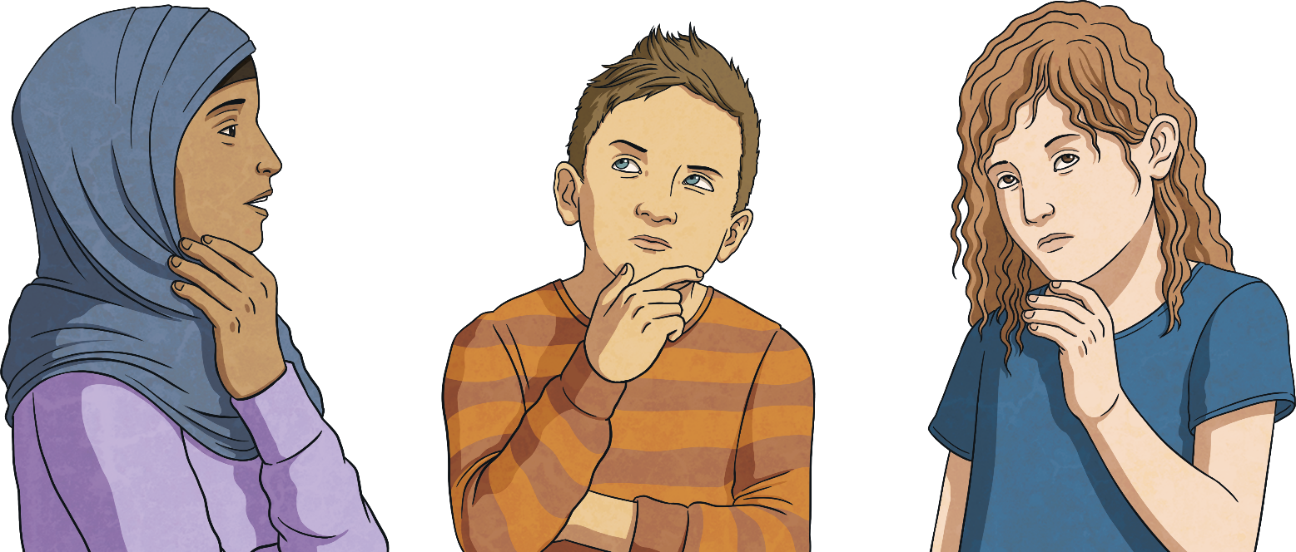
Smashing Stereotypes in Science
Now, look at your drawings of scientists as a class.
Do they all show the same thing? Or are there differences?
Sometimes people have a stereotypical idea of what a scientist looks like.
However, scientists are actually a diverse group of people.
What do you think the words stereotype and diverse mean?

Slide 7
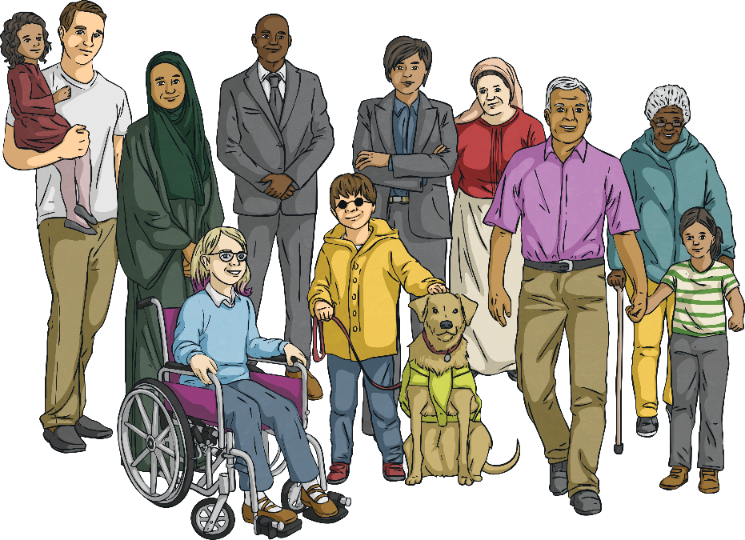
Smashing Stereotypes in Science
Diverse means a wide variety.
You can have a diverse range of people - this means they’re all from different backgrounds.
Scientists come from a diverse range of backgrounds. They have a diverse range of jobs and work in diverse ways in a range of diverse places.
Diversity is the noun we use when there is a wide variety of something.
A stereotype describes the set ideas people have about what a certain group of people are like.
For example, a stereotype would be that scientists are men in lab coats carrying around bubbling potions.
There is not one fixed image of a scientist - they are diverse!
Scientists are everyday people often working together to do great things in their everyday jobs.
One of the themes of this year’s British Science Week is ‘Smashing Stereotypes’ and looking at how diverse scientists are and celebrating this.
Today, we are going to look at the diversity of scientists and smash the stereotype!
X
Why is it important that we ‘smash the stereotype’ of a scientist?

Slide 8
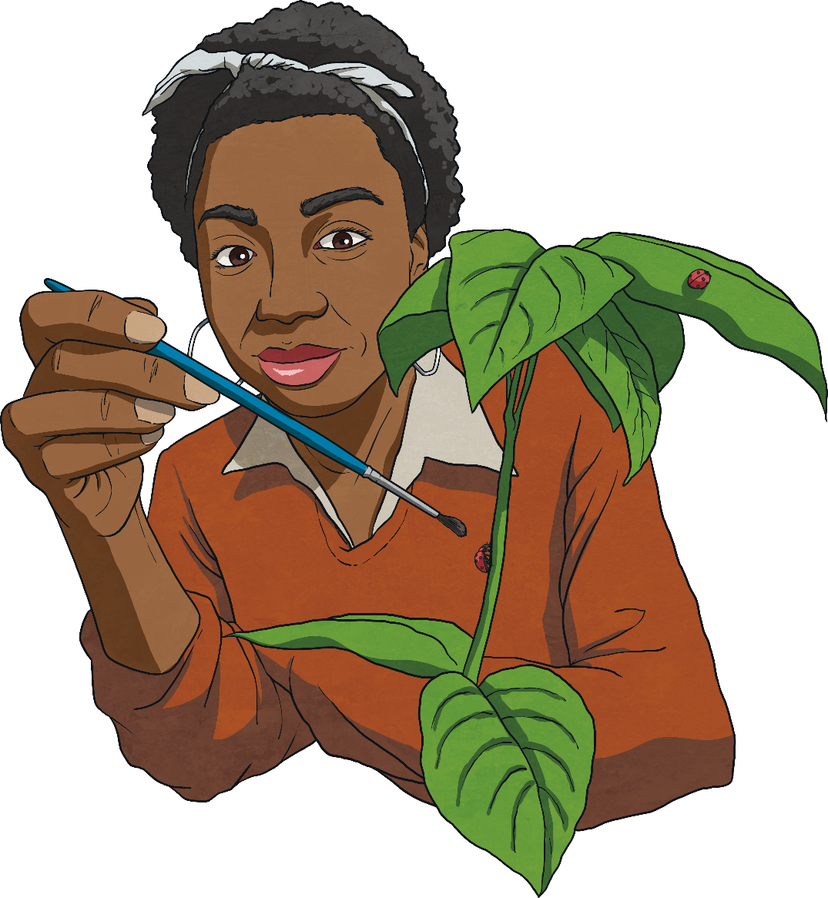
Types of Scientist
There are almost too many types of scientist to count! Here are a few examples to show the diversity of roles a scientist may have:
Entomologist
An entomologist is a scientist that studies insects and how they interact with us, the environment and other living things.
Entomologists might work on discovering new species of insects, looking at the insects important role in habitats, researching how some insects spread disease and studying their role in agriculture.
Depending on their specialism, they may work in all sorts of places including outdoors, in a lab or in a museum.

Slide 9
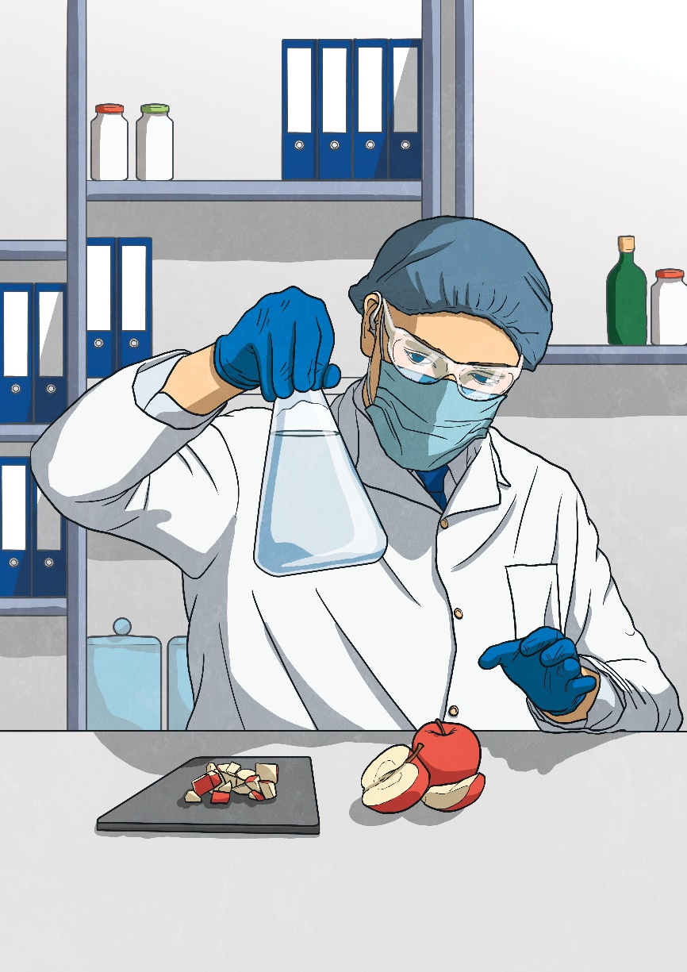
Types of Scientist
Food Scientist
A food scientist creates food and drink products and makes sure they are safe for us to consume.
Their role can include investigating how to preserve food, putting together nutritional information and developing recipes.
They often work in lab settings or research facilities.

Slide 10
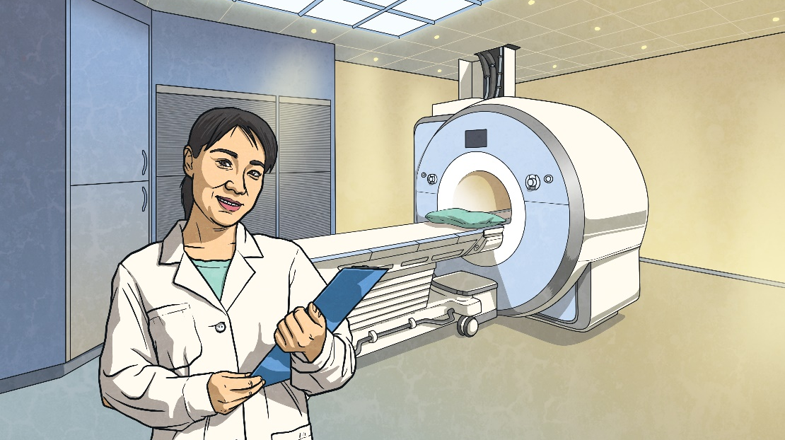
Types of Scientist
Medical Physicist
Medical physicists work in healthcare. They are responsible for working with specialist equipment and techniques used to diagnose illnesses and treat people.
Their work could include designing, testing and monitoring. They may also analyse results, plan treatment and many work with patients.
Medical physicists may use specialist equipment such as MRI scanners, x-rays, ultrasound scanners and radiotherapy machines.
These jobs are often based in hospitals.

Slide 11
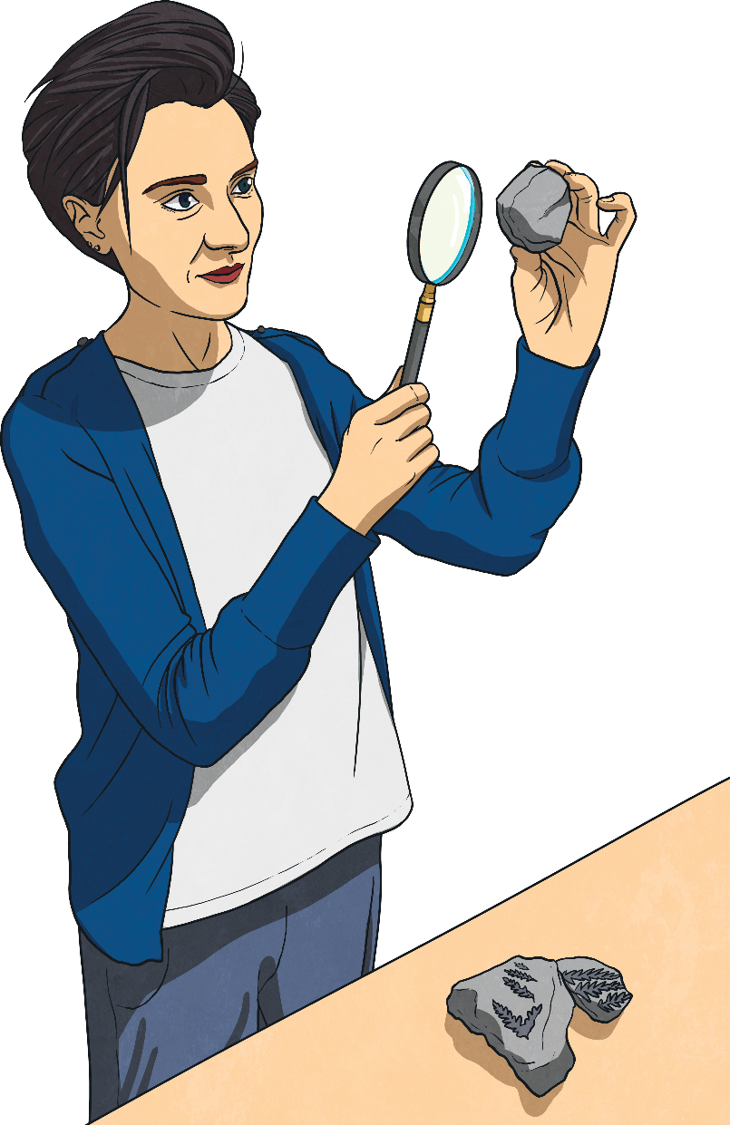
Types of Scientist
Palaeontologist
Palaeontologists use fossils to study the history of life on Earth.
Their work includes collecting, classifying and using technology to examine samples.
They can work with all sorts of fossil types, including vertebrates, invertebrates, plants and microorganisms. Some even look at fossil footprints.
Palaeontologists can also be involved in managing exhibitions, working on TV programmes and giving talks about their work.
X
What do you think the stereotype of a palaeontologist is? Is this true?
They can work at field sites, in museums, labs and offices.

Slide 12
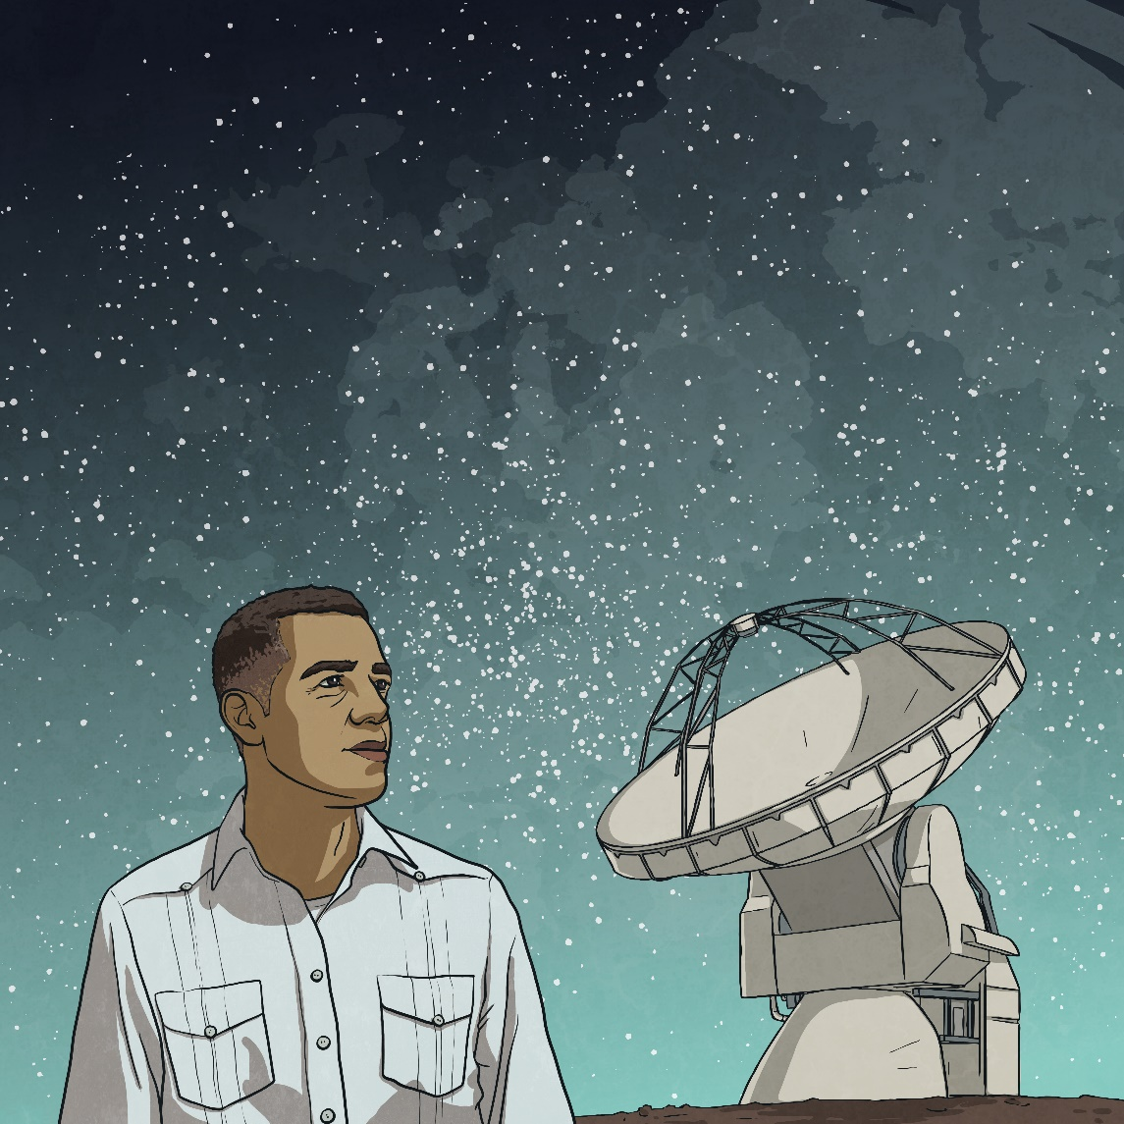
Types of Scientist
Astronomer
Astronomers study the universe.
They might study stars, planets, galaxies or black holes.
Astronomers can make observations using telescopes, satellites and spacecraft.
They may also come up with and test theories using existing data, observations and computer models.
They often work at universities, observatories or labs.

Slide 13
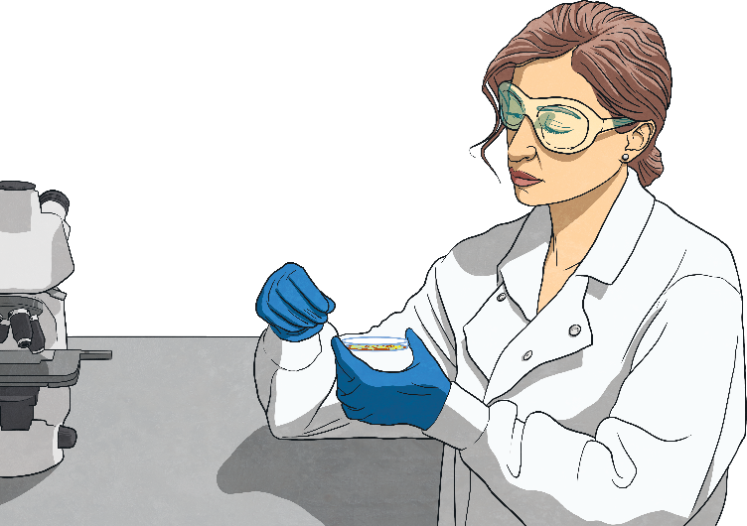
Types of Scientist
Microbiologist
Microorganism: an organism that is so small it cannot be seen by the naked eye. Includes bacteria and fungi.
Some microorganisms are harmful to us (for example, they can make us unwell) but many are useful. Some microorganisms can actually be used to make medicines. They can be used in food production and cleaning up polluted areas.
Microbiologists study microorganisms and can work in many diverse areas.
Some microbiologists study microorganisms that cause infectious diseases and they work to identify, monitor and control these. They may also work on how we can use microorganisms to produce medical products.
Microbiologists may work on identifying and classifying new species of microorganisms and the roles of microorganisms in the environment.
They may study the use of microorganisms in food production.
X
Can you identify and describe some of the many different jobs scientists can do?
Microbiologists generally work in hospitals, labs and universities.

Slide 14
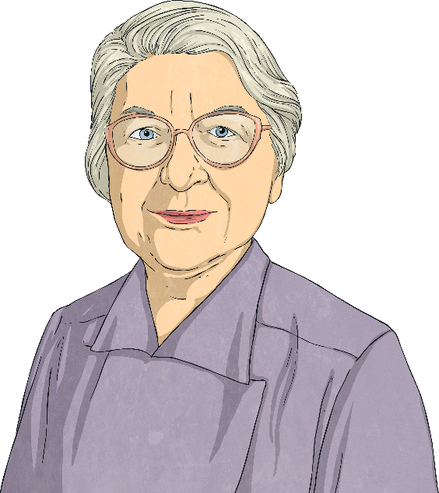
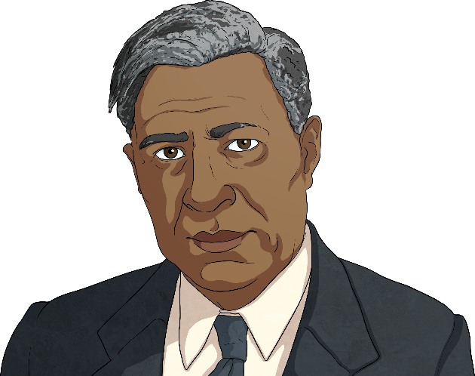
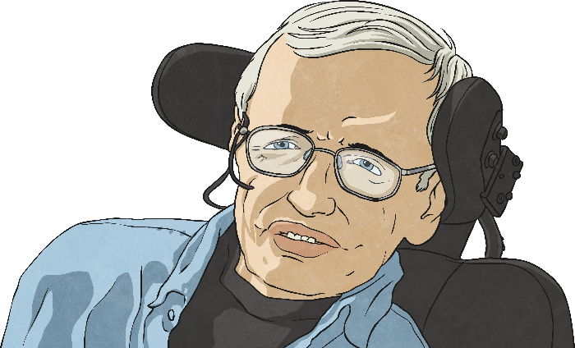
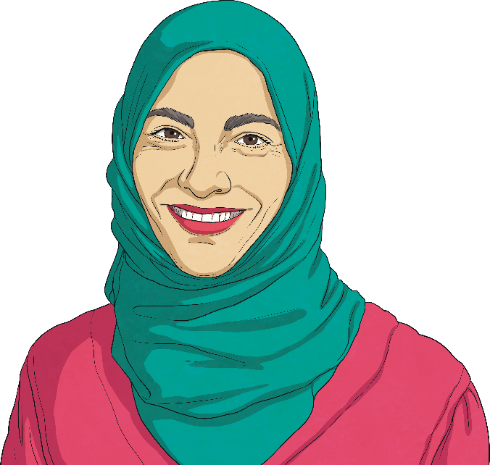
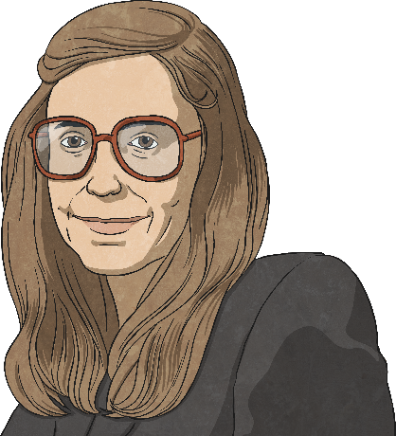
Inspirational Scientists
Scientists study many different aspects of the world around us and have come from all sorts of different backgrounds with different experiences and routes to their jobs.
Does anyone know a real scientist?
Here are some examples of well-known scientists that we are going to be discussing.
They show the diversity of scientists - from their background to the area of science that they work in.

Slide 15
Inspirational Scientists
Garrett Morgan was an American inventor and entrepreneur born in 1877.
He invented a safety hood which was the first version of the modern gas mask.
Another of his most famous inventions was the first three-signal traffic light.
His achievements are especially impressive because he only went to school up until the age of 12.
It was difficult for Garrett Morgan to achieve his many successes due to the racism that he experienced. Sadly, due to racial discrimination, when some companies realised the Morgan Safety Hood was made by a Black inventor, they cancelled their orders.
Garrett Morgan

Slide 16
Inspirational Scientists
Stephanie Kwolek was born in 1923 in Pennsylvania, USA.
Her father was interested in science and passed this interest on to her.
She completed university with a degree in chemistry.
Kwolek invented a material called ‘Kevlar’ which is lightweight but exceptionally strong.
Kevlar is used for car tyres, bulletproof clothing, protective gloves, diving equipment, boots, helmets and fireproof clothing.
Stephanie Kwolek

Slide 17
Inspirational Scientists
Stephen Hawking was a famous scientist and theoretical astrophysicist.
He was diagnosed with Amyotrophic Lateral Sclerosis (ALS) aged 21 and given just two years to live.
However, Hawking lived until he was 76 and, during this time, he made a huge contribution to how we understand the universe.
He used a wheelchair and a computer with a voice synthesizer to talk.
Hawking developed theories about how black holes are formed, how they behave and where they can be found in the universe.
He also authored many books which have helped millions of people to understand difficult scientific concepts.
Stephen Hawking

Slide 18
Inspirational Scientists
While working at NASA, Hamilton was responsible for programming the on-board flight software on the Apollo computers. She wrote code that was used to navigate and land spacecraft safely.
A problem with the Apollo computer becoming overloaded was overcome by a program Hamilton had written. If she had not added this program, the landing of the Apollo 11 spacecraft on the Moon (carrying the first people to set foot on the Moon, Neil Armstrong and Buzz Aldrin) would not have succeeded.
Margaret Hamilton's work in computer engineering set the standard for the use of computers in space travel.
She was the first person to really understand how software and computer programs could be used to make things happen.
At that time, there were no earlier software projects to learn from, or classes in software engineering. Hamilton taught herself everything and referred to herself as a software engineer.
Margaret Hamilton

Slide 19
Inspirational Scientists
Sindi co-founded a non-profit organisation that creates devices that diagnose disease.
These devices are low-cost and easy-to-use and have been designed for use in the developing world.
She also works to promote science education and innovation, especially to young people.
Hayat Sindi was born in Makkah, Saudi Arabia.
She has a PhD in biotechnology and was the first female from the Gulf to earn this.
She is a biotechnologist and works to promote science education.
Hayat Sindi

Slide 20
You as a Scientist
What qualities and skills do the scientists we have looked at have?
In your group you have 5 minutes to write down as many qualities and skills as you can think of.
Think about which of these attributes you have yourself.
Could you be a scientist?

Slide 21
You as a Scientist
With your partner, discuss:
Would you like to work as a scientist? Why?
Has today changed your mind about what a scientist does? Would you like to do any of the jobs you’ve learnt about?
Can you describe a stereotypical view of a scientist and explain why it is not true?
Can you explain why we say that scientists are diverse?
Can you think of any other jobs scientists do?

