Slide 1
WALT: Understand how to create shades and tints by mixing colours
I understand what a shade and a tint is
I can experiment with making shades and tints
I can record how to make a shade or tint so I can repeat the process in the future

Slide 2
Vocabulary
paint
canvas
precision
detail
sketch
viewpoint
colour mixing
shade
tint
tone

Slide 3
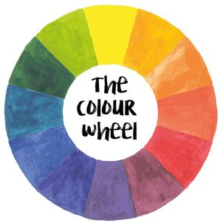
What do you already know?
Primary colours?
How do we make secondary colours?
What happens when we mix these colours?

Slide 4
Quick Quiz!

Slide 5
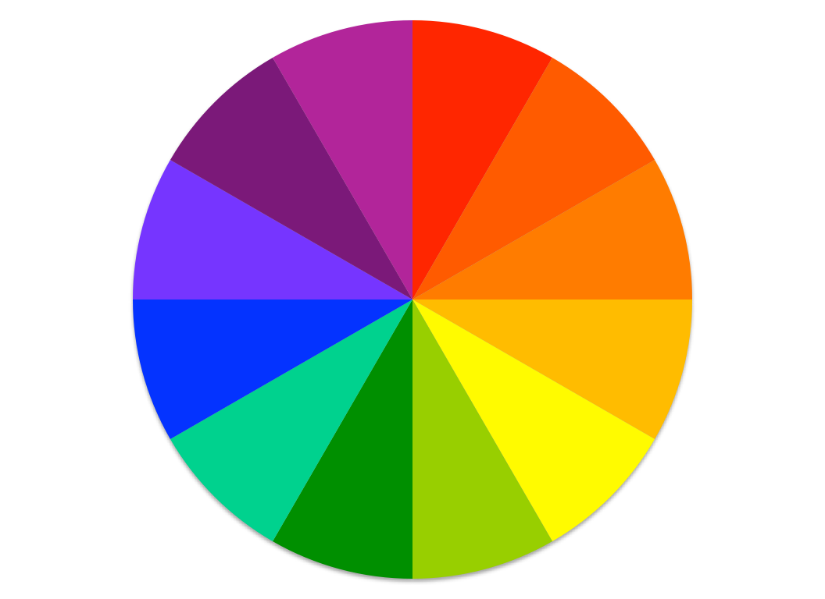
TERTIARY COLOUR WHEEL
PRIMARY COLOUR + SECONDARY COLOUR = TERTIARY COLOUR
+
=
?
T
P
S
T
+
=
?
T
S
+
=
?
P
T
+
=
?
T
P
S
T
+
=
?
LEARNING OBJECTIVE: UNDERSTAND HOW TO CREATE TINTS + SHADES THROUGH MIXING COLOUR
LITERACY OBJECTIVE: UNDERSTAND + APPLY THESE KEY WORDS... TERTIARY / TINT / SHADE
NUMERACY OBJECTIVE: EXPERIMENT WITH RATIO TO CREATE DIFFERENT SHADES + TINTS

Slide 6
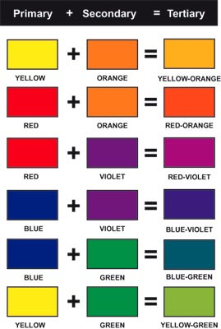
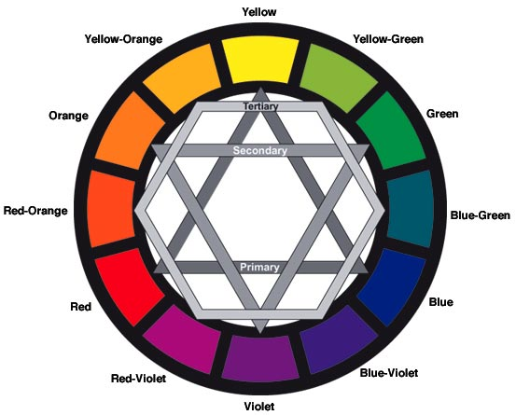
colour MIXING Tertiary colours
Mixing primary and secondary colours creates tertiary colours. Tertiary colours include:
Red-Violet
Blue-Violet
Blue-Green
Yellow Green
Red-Orange
Yellow-Orange
On the colour wheel, the tertiary colours are located between the primary and secondary colours they are made from.

Slide 7
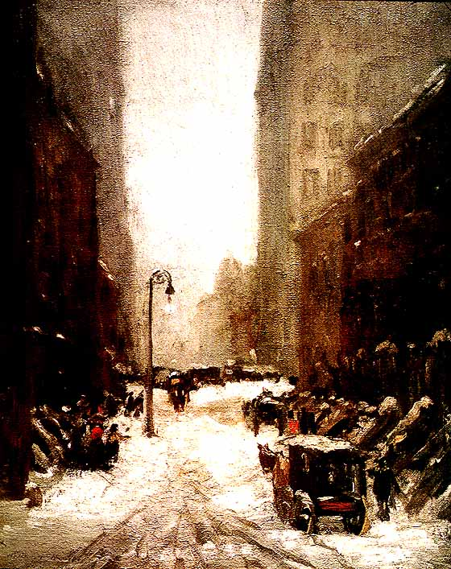
colour MIXING neutrals
Neutrals don't usually show up on the colour wheel. Neutrals include black, white, grey, and sometimes brown and beige. They are sometimes called “earth tones.”
There are a few different ways to make neutrals. You can blend black and white to make grey.
You can create brown in two ways—by blending two complementary colours together or by blending all three primary colours together.
Snow in New York
by Robert Henri
In Snow in New York, Robert Henri uses many different neutrals. You can see a few glimpses of red paint, but the overall effect is of natural browns, whites and grays--like those you might see in rocks, sand, dirt, or clay.

Slide 8
Watch https://www.bbc.co.uk/bitesize/guides/z3bqycw/video

Slide 9
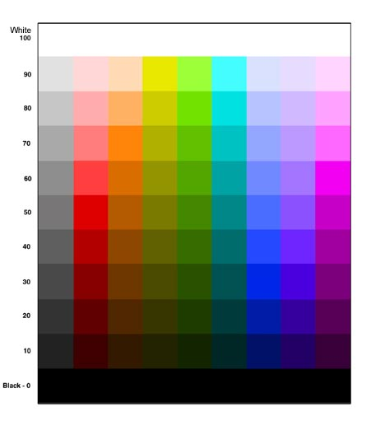
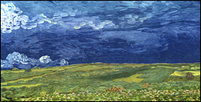
colour MIXING Tints and Shades
A shade of colour is made by mixing that colour with black.
A tint of colour is made by mixing that colour with white.
This painting by Vincent Van Gogh, Fields in a Rising Storm, has tints and shades of blue in the sky, and tints and shades of green in the fields.

Slide 10
TINTS
COLOUR + WHITE = TINT
+
=
1/2
1/2
+
=
1/3
2/3
+
=
Lighter
1/4
3/4

Slide 11
SHADES
COLOUR + BLACK = SHADE
+
=
1/2
1/2
+
=
1/3
2/3
+
=
Darker
1/4
3/4

Slide 12
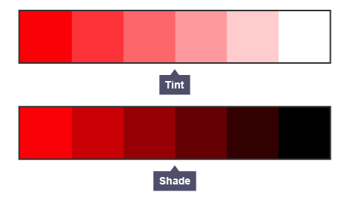

Slide 13
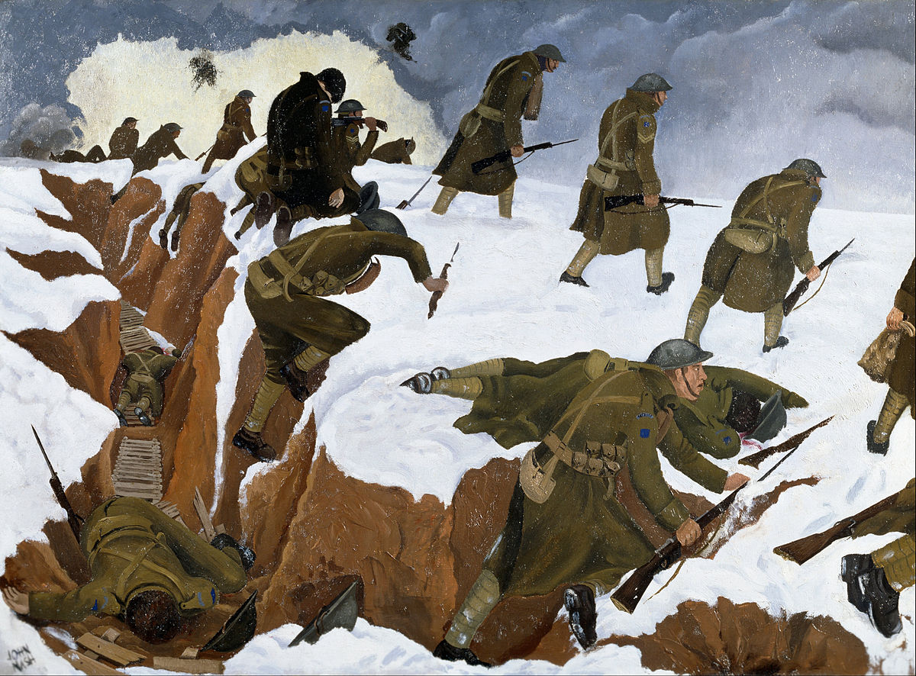
‘Over the Top’ (1918)
What are the main colours used in the painting?
Are they primary, secondary or tertiary?

Slide 14
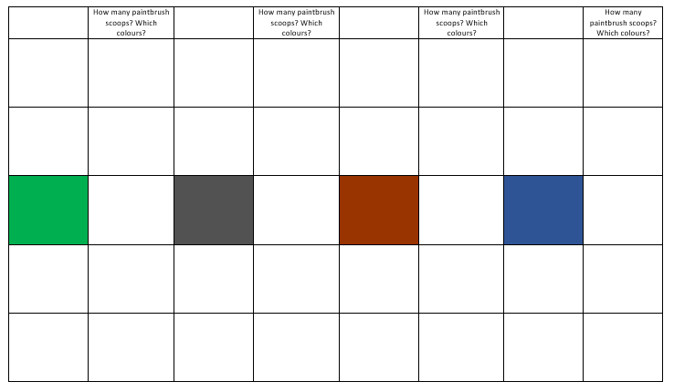
Your Task

Slide 15
WALT: Understand how to create shades and tints by mixing colours
I understand what a shade and a tint is
I can experiment with making shades and tints
I can record how to make a shade or tint so I can repeat the process in the future

