Slide 1
Word of the Day
Spiralling

Slide 2
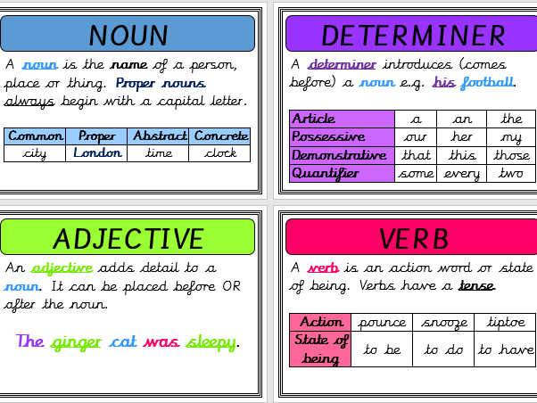
Definition and word class

Slide 3
Word of the Day
spiralling
(verb)
show a continuous and dramatic increase.

Slide 4
Write 3 times spiralling spiralling spiralling

Slide 5
Speed write for 1 minute! spiralling

Slide 6
Exemplar Sentence
Despite being brothers, the two boys could not be more different to each other; their parents felt their behaviour was spiralling out of control.

Slide 7
Oral Creation and Rehearsal

Slide 8
Orally share, edit and improve

Slide 9
Write

Slide 10
Share, edit and celebrate!

